Slide 1
Factory Automation and Control Methods
Lecture 2: Manufacturing Operations
Daro VAN
Paragon International University
Faculty of Engineering
Department of Industrial Engineering

Slide 2
Outline
Manufacturing Industries and Production
Manufacturing Operation
Production Facilities
Product/Production Relationships
Lean Production

Slide 3
1. Manufacturing Industries and products
Classification of Industries
Primary industries – cultivate and exploit natural resources Ex. Agriculture, mining
Secondary industries – convert output of primary industry to products Ex. Manufacturing, power generation, construction
Tertiary industries – service sector Ex. Banking, education, government, legal services, retail trade, transportation

Slide 4
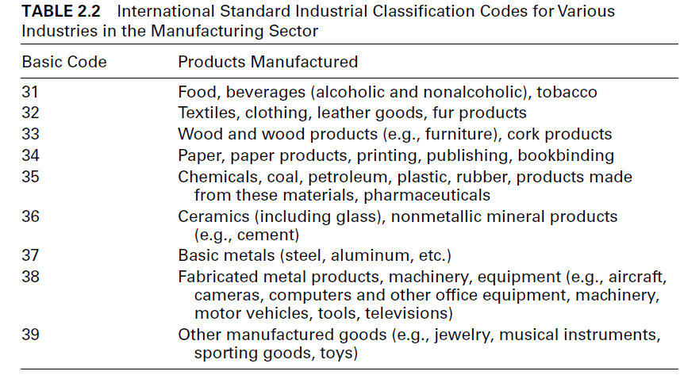
1. Manufacturing Industries and products

Slide 5
2. Manufacturing industry and products
Process industries, e.g., chemicals, petroleum, basic metals, foods and beverages, power generation
Discrete product (and part) industries, e.g., car, aircraft, appliances, machinery, and their component parts

Slide 6
2. Manufacturing Operations
Transformation Process
Raw materials
Processing and assembly operations
Material handling
Inspection and testing
Coordination and control
Finished products
Scrap or
waste
Power
Tools
Machines
Labor

Slide 7
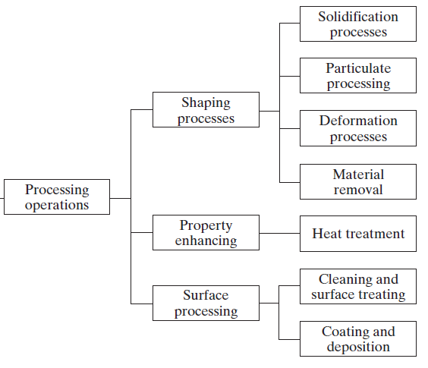
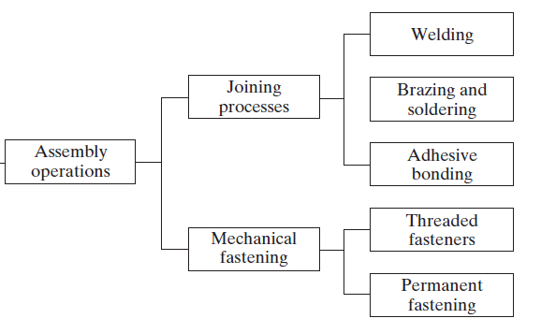
2. Manufacturing Operations Processing and Assembly Operation

Slide 8
2. Manufacturing Operations Processing Operation
Shaping operations
Solidification processes
Particulate processing
Deformation Processes
Material removal processes
Properties-enhancing operation (heat treatments)
Surface processing operation
Cleaning and surface treatments
Coating and thin-film deposition

Slide 9
2. Manufacturing Operations Assembly Operation
Joining processes
Welding
Brazing and soldering
Adhesive bonding
Mechanical assembly
Threaded fasteners (e.g., bolts and nuts, screws)
Rivets
Interference fits (e.g., press fitting, shrink fits)
other

Slide 10
2. Manufacturing Operations Other factory operations
Material handling
Material transport
Vehicle, e.g., forklift trucks, monorials
Conveyors
Cranes…
Storage systems
Unitizing equipment
Automatic identification and data capture
Bar codes….

Slide 11
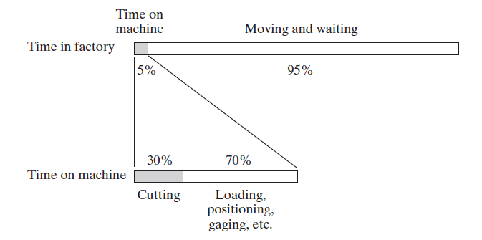
2. Manufacturing Operations Other factory operations
Time Spent in Material handling

Slide 12
2. Manufacturing Operations Other factory operations
Inspection and testing
Inspection – conformance to design specifications
Inspection for variables – measuring
Inspection of attribute – gauging
Testing – observing the product (or part, material, subassembly) during operation

Slide 13
2. Manufacturing Operations Other factory operations
Coordination and Control
Regulation of the individual processing and assembly operations
Process control
Quality control
Management of plant level activities
Production planning and control
Quality control

Slide 14
3. Production Facilities
Facilities organized in the most efficient way to serve the particular mission of the plant and depends on:
Type of products manufactured
Production quantity
Product variety

Slide 15
3. Production Facilities
Production quantity (IQ)
Number of units of a given part or product produced annually by a plant
Three quantity ranges
Low production – 1 to 100 units
Medium production – 100 to 10,000 units
High production – 10,000 to millions of units

Slide 16
3. Production Facilities
Production variety (P)
Number of different product or part designs or types
‘Hard’ product variety – products differ greatly
Few common components in an assembly
‘Soft’ product variety – small differences between products
Many common components in an assembly

Slide 17
3. Production Facilities
Low production quantity
Job shop – makes low quantities of specialized and customized products
Products are typically complex (e.g., specialized machinery, prototypes, space capsules)
Equipment is general purpose
Plant layouts
Fixed position
Process layout

Slide 18
3. Production Facilities
Medium production quantity
Batch production – a batch of a given product is produced, and then the facility is changed over to produce another product
Changeover takes time – setup time
Typical layout – process layout
Hard product variety
Cellular manufacturing – A mixture of products is made without significant changeover time between products
Typical layout – cellular layout
Soft product variety

Slide 19
3. Production Facilities
High production
Quantity production – Equipment is dedicated to the manufacturing of one product
Standard machines tooled for high production (e.g., stamping presses, molding machines)
Typical layout – process layout
Flow line production – Multiple workstations arranged in sequence
Product requires multiple processing or assembly steps
Production layout is most common

Slide 20
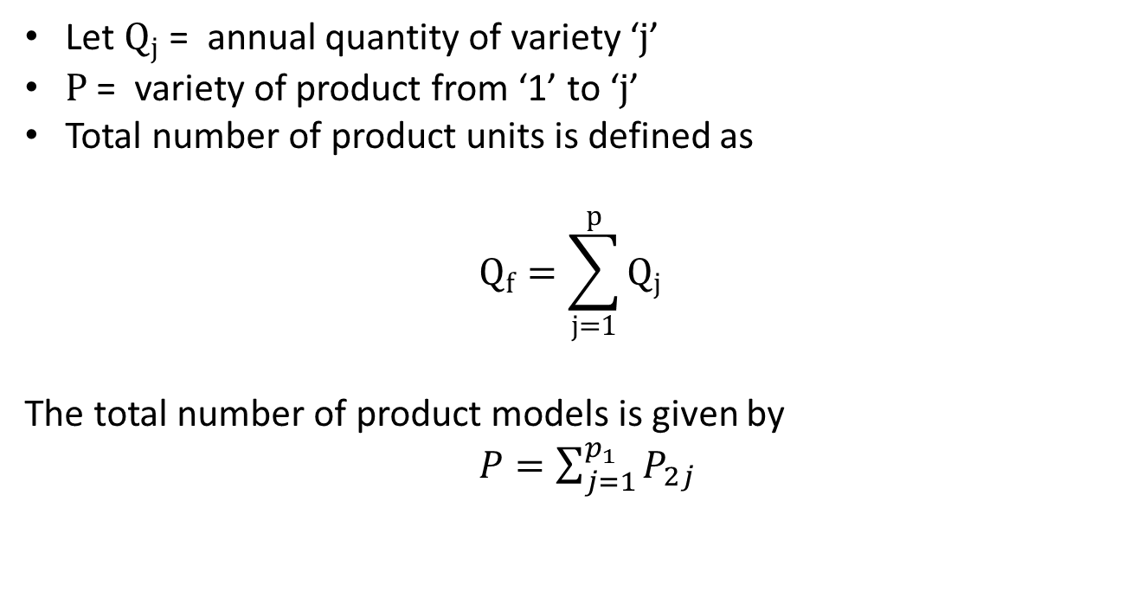
4. Product/Production Relationships 4.1 Production Quantity and Production Variety
Let $Q_{j}$ = annual quantity of variety ‘$j$’
$P$ = variety of product from ‘1’ to ‘$j$’
Total number of product units is defined as
$$Q_{f}=\sum_{j=1}^{p}{Q_{j}}$$ The total number of product models is given by
$P=\sum_{j=1}^{p_{1}}{P_{2j}}$

Slide 21
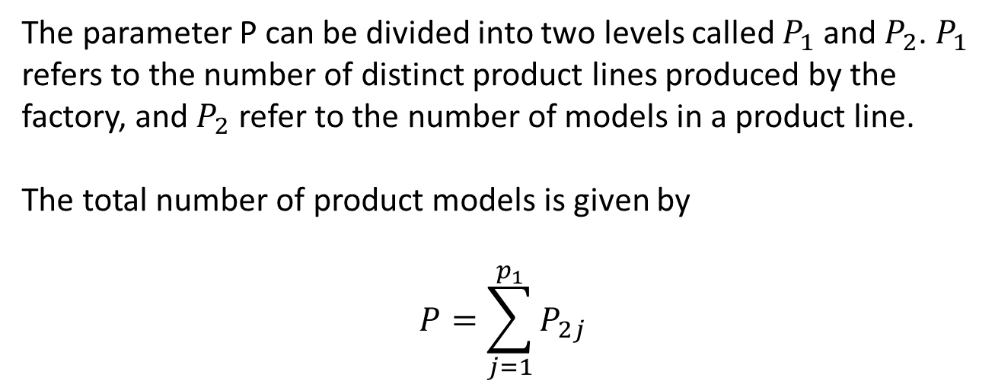
4. Product/Production Relationships 4.1 Production Quantity and Production Variety
The parameter P can be divided into two levels called $P_{1}$ and $P_{2}$. $P_{1}$ refers to the number of distinct product lines produced by the factory, and $P_{2}$ refer to the number of models in a product line. The total number of product models is given by
$$P=\sum_{j=1}^{p_{1}}{P_{2j}}$$

Slide 22
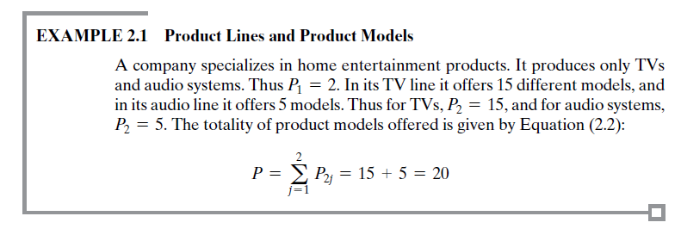
4. Product/Production Relationships 4.1 Production Quantity and Production Variety

Slide 23
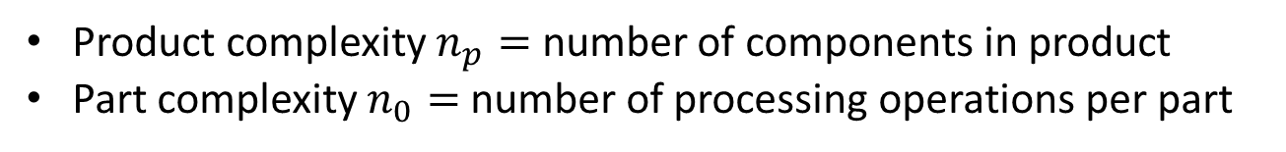
4. Product/Production Relationships 4.1 Production Quantity and Production Variety
Product complexity $n_{p}=$ number of components in product
Part complexity $n_{0}=$ number of processing operations per part

Slide 24
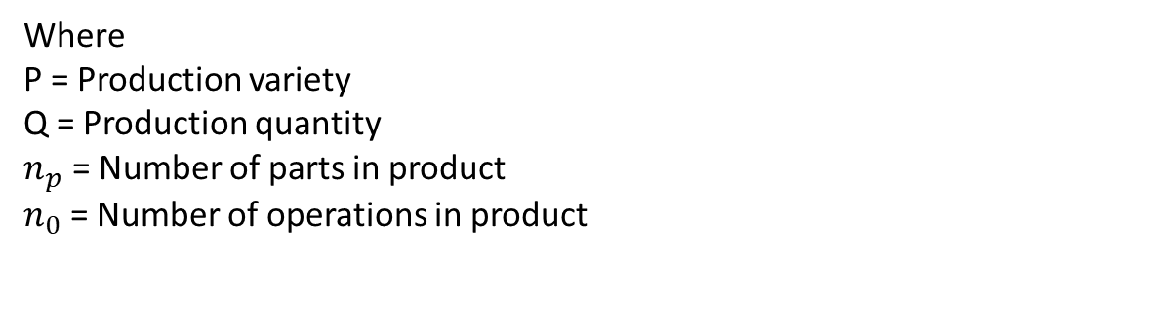
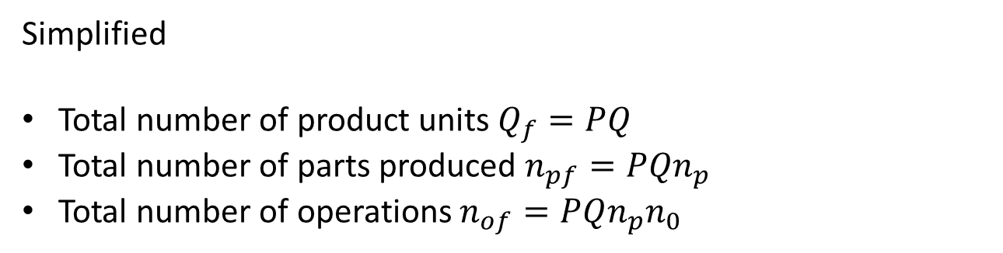
4. Product/Production Relationships Factory Operation Model
Simplified
Total number of product units $Q_{f}=PQ$
Total number of parts produced $n_{pf}=PQn_{p}$
Total number of operations $n_{of}=PQn_{p}n_{0}$
Where
P = Production variety
Q = Production quantity
$n_{p}$ = Number of parts in product
$n_{0}$ = Number of operations in product

Slide 25
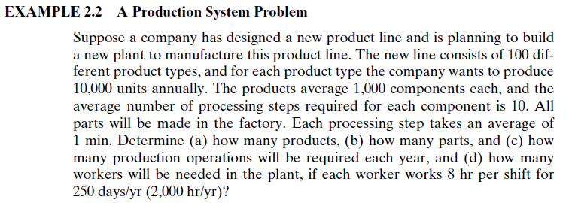
4. Product/Production Relationships Factory Operation Model

Slide 26
4. Product/Production Relationships Manufacturing Capability
Technological processing capability – the available set of manufacturing processes
Physical size and weight of product
Production capability (plant capability) – production quantity that can be made in a given time

Slide 27
4. Product/Production Relationships Lean Production
Operating the factory with the minimum possible resources and yet maximizing the amount of work accomplished
Utilization of resources – workers, equipment, time, space, materials
Minimizing time
Maximizing quality ( accuracy)
Minimizing cost
Doing more with less, and doing it better

Slide 28
4. Product/Production Relationships Programs Associated with Lean Production
Just-in-time delivery of parts
Worker involvement
Continuous improvement
Reduced setup times
Stop the process when somethings is wrong
Error prevention
Total productive maintenance

Slide 29
References
Mikell P. Groover, “Automation, Production Systems and Computer-integrated Manufacturing” , 4th edition, Pearson, chapter 2

